Slide 1
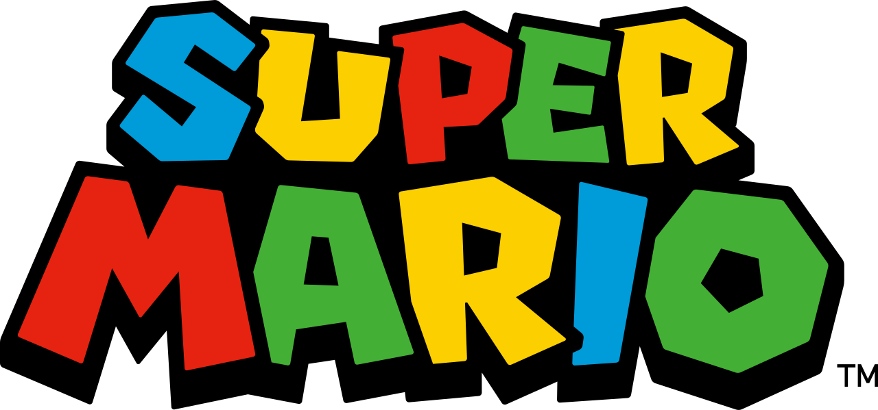
Super Mario

Slide 2
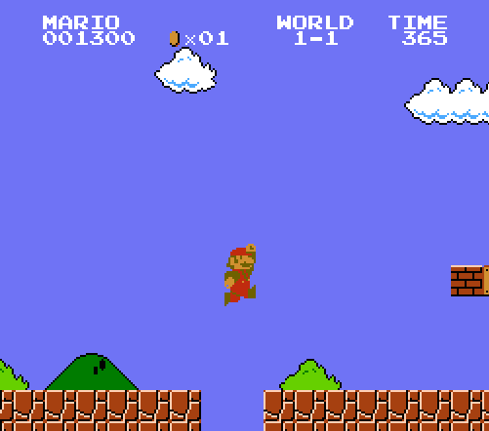
What are the characteristics of Super Mario Bros?

Slide 3
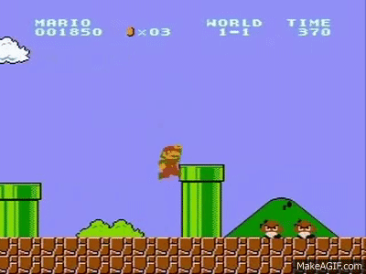
Key characteristics (requirements)
Side scroller: Mario/Camera moves right
Gravity effect of jump
Collects coins and optional powerups
Enemies (Goombas) try to take lives.
Time limit in which Mario must reach the end of the level
Notes:
https://protipoftheday.com/node/113.html

Slide 4
Steps / Requirements
Level Design in Unity
Mario Movement (left + right)
Object detection / collision
Jumping over blocks / gravity
Enemies (Goombas) alternate directions
Jumping on Goombas – further collisions
Decoration – animation – walking
Camera to track Mario (once tile map created)

Slide 5
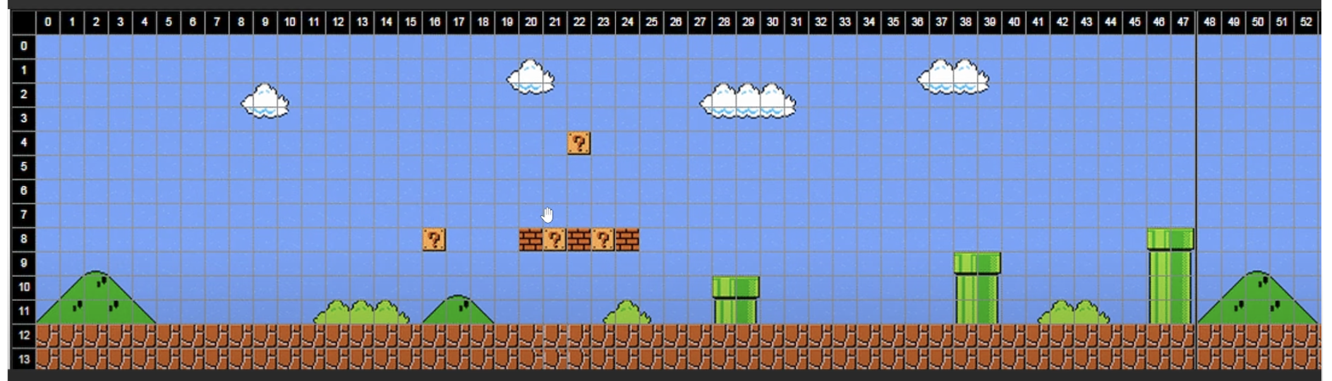
Unity Level tilemap

Slide 6


Slide 7
Steps / Requirements
Level Design in Unity
Mario Movement (left + right)
Object detection / collision
Jumping over blocks / gravity
Enemies (Goombas) alternate directions
Jumping on Goombas – further collisions
Decoration – animation – walking
Camera to track Mario (once tile map created)

Slide 8
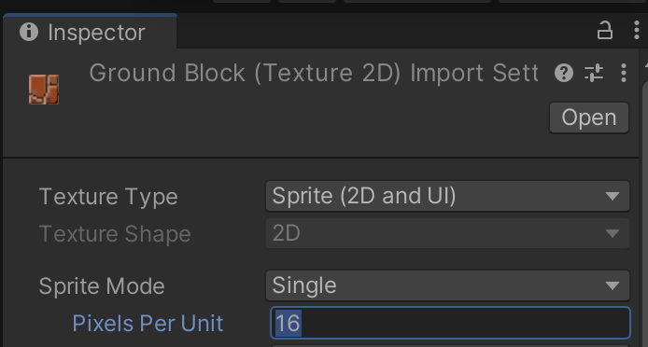
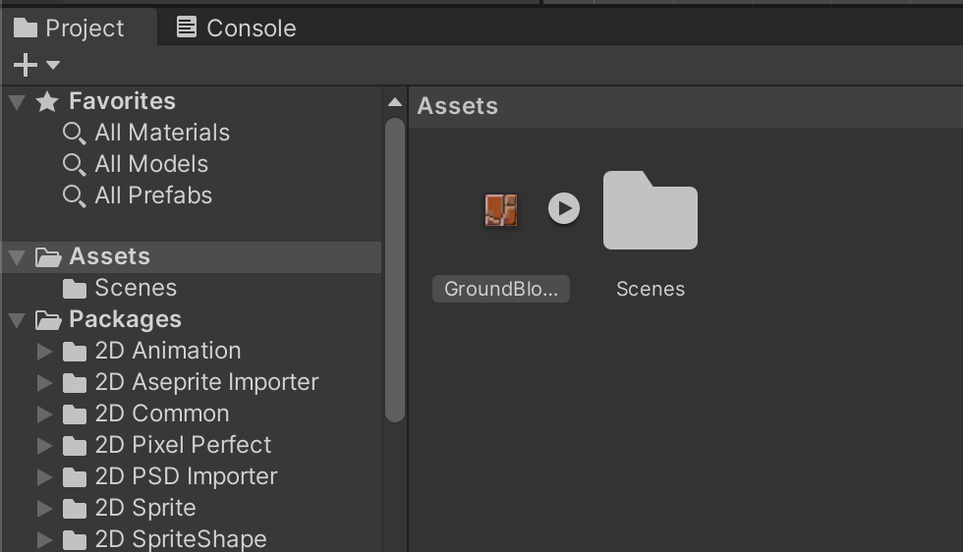
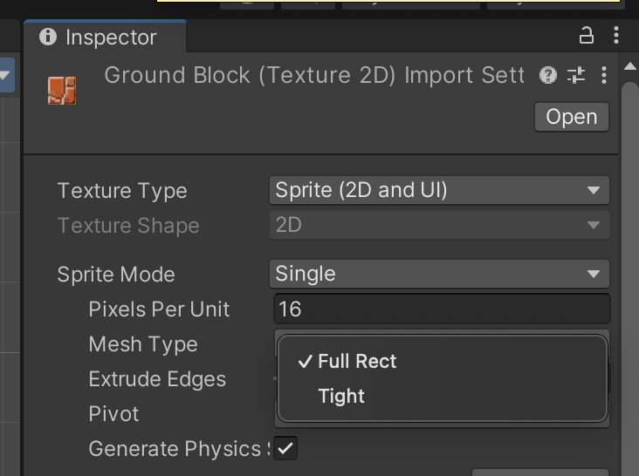
Level Design - load in Ground Block Pixels Per Unit = 16

Slide 9
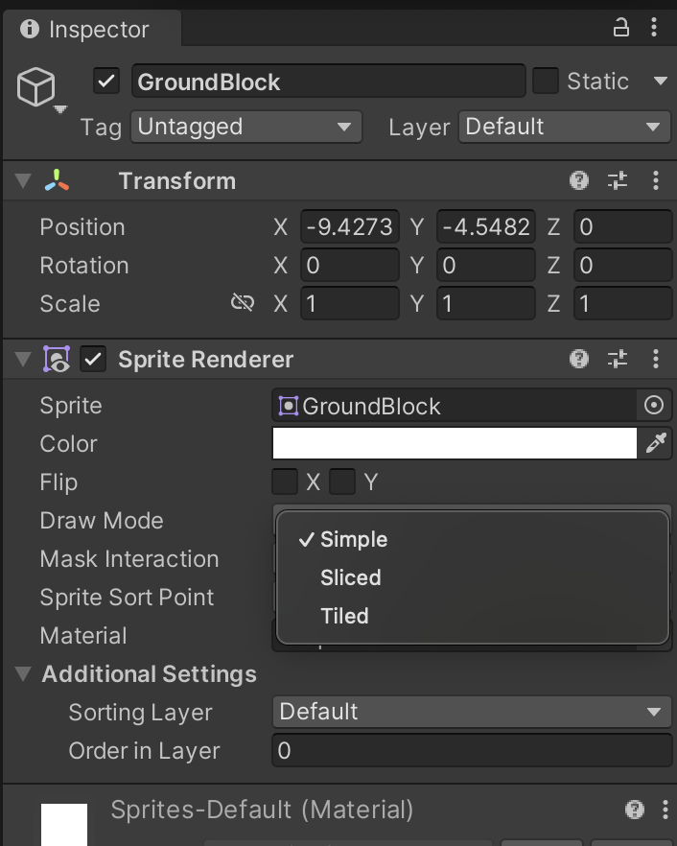
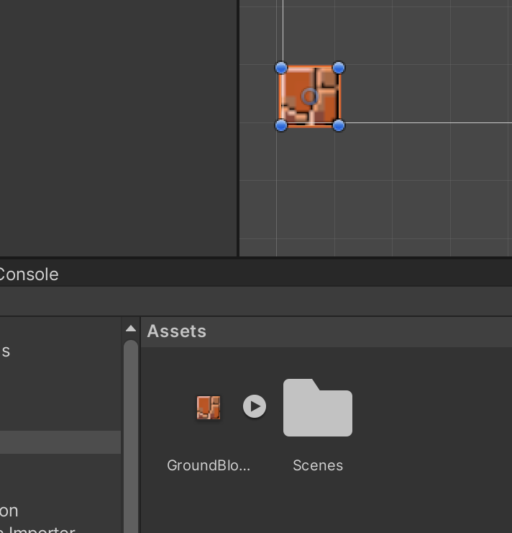
Select ‘Tiled’

Slide 10
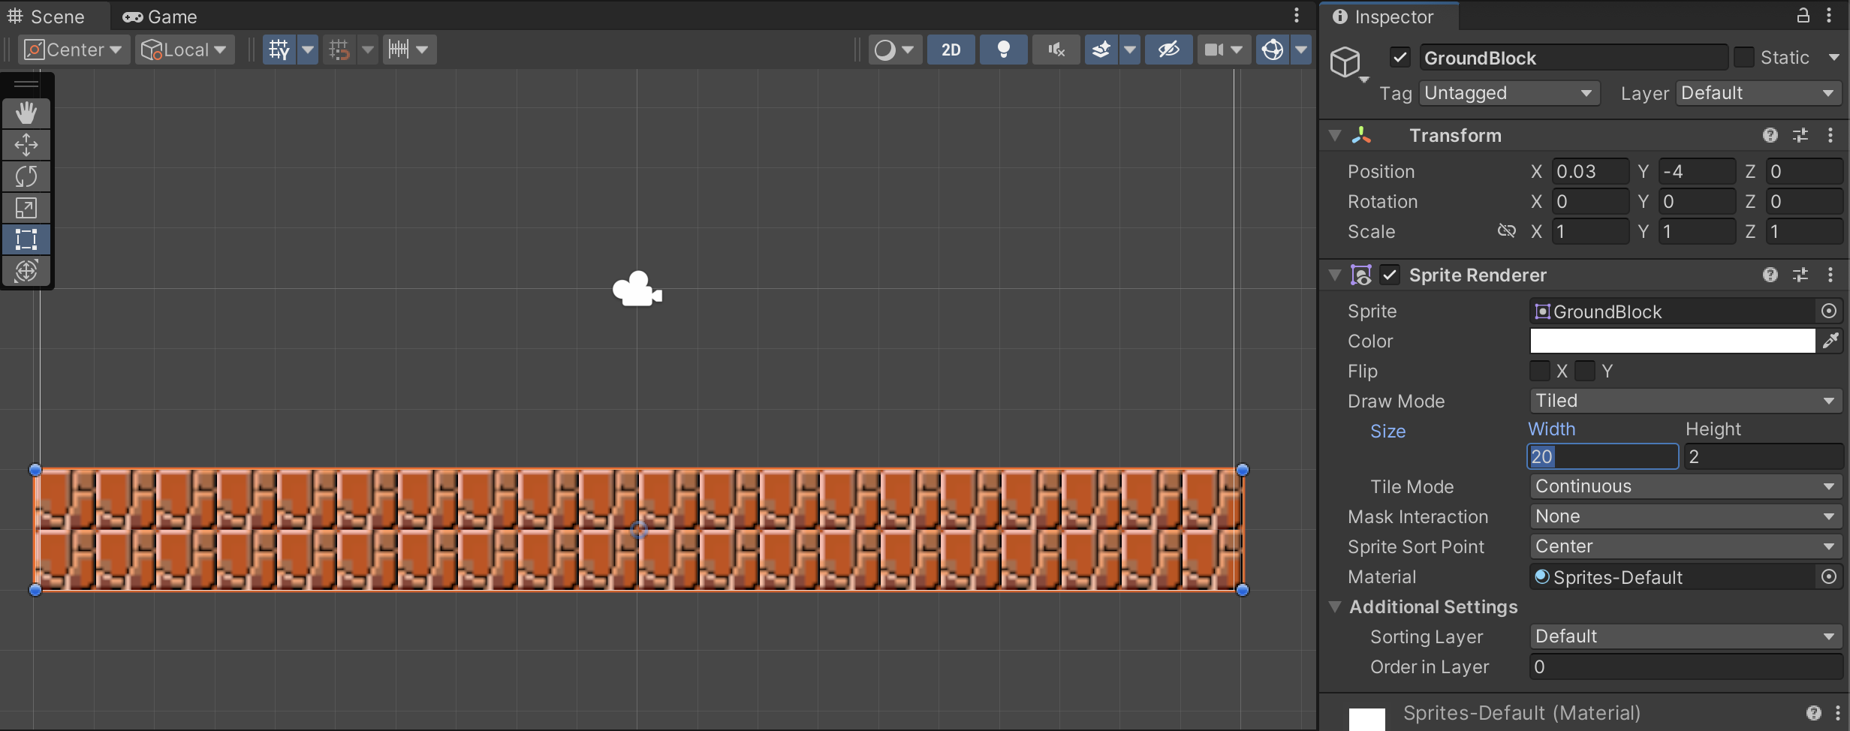
Tiled Draw Mode – 20 tiles wide x 2 high

Slide 11
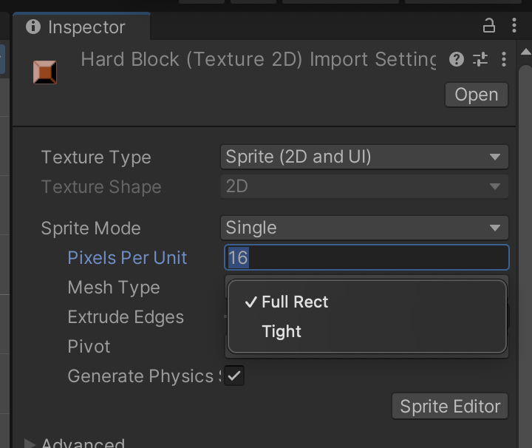
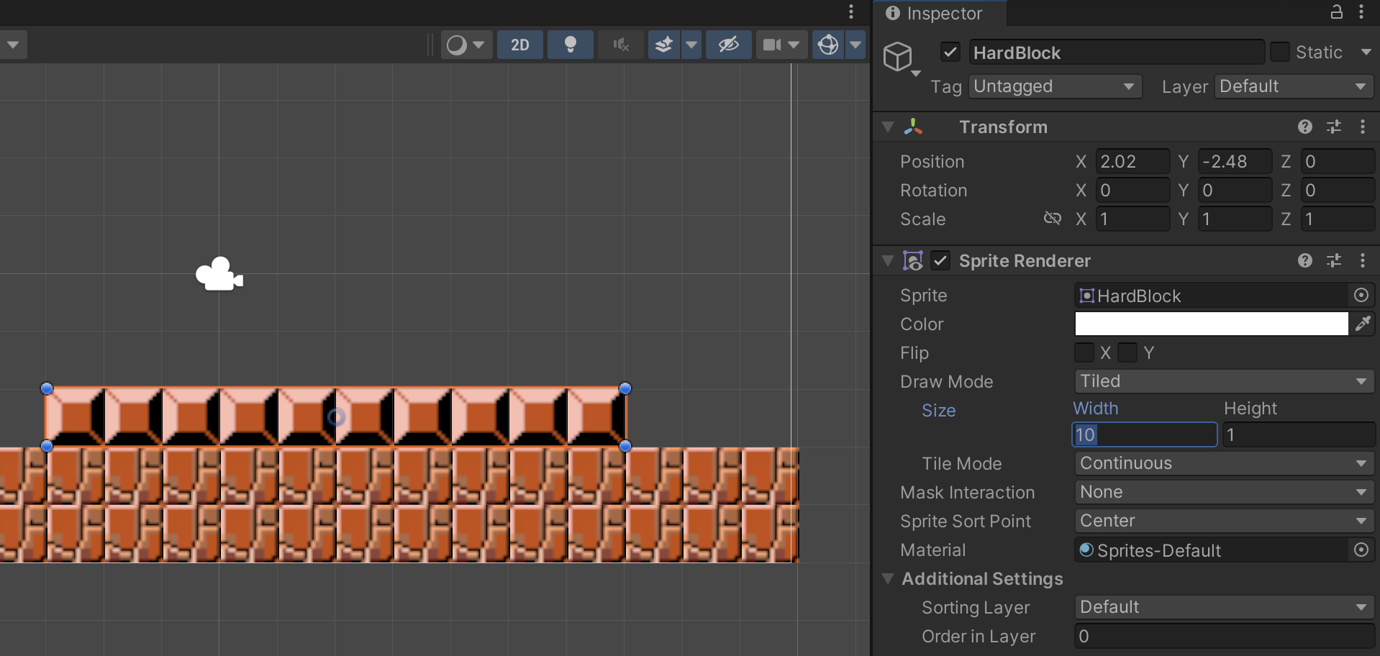
In Unity – Select Tiled

Slide 12
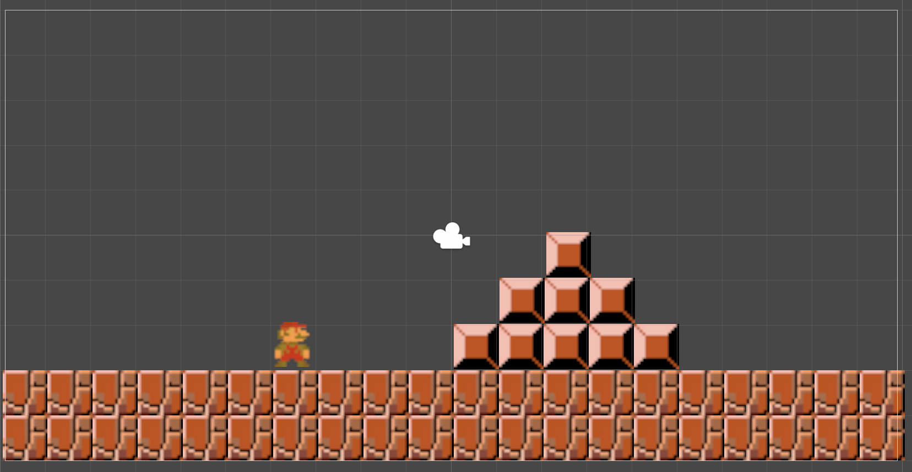
Simple Level Design

Slide 13
Steps / Requirements
Level Design in Unity ✅
Mario Movement (left + right)
Object detection / collision
Jumping over blocks / gravity
Enemies (Goombas) alternate directions
Jumping on Goombas – further collisions
Decoration – animation – walking
Camera to track Mario (once tile map created)

Slide 14
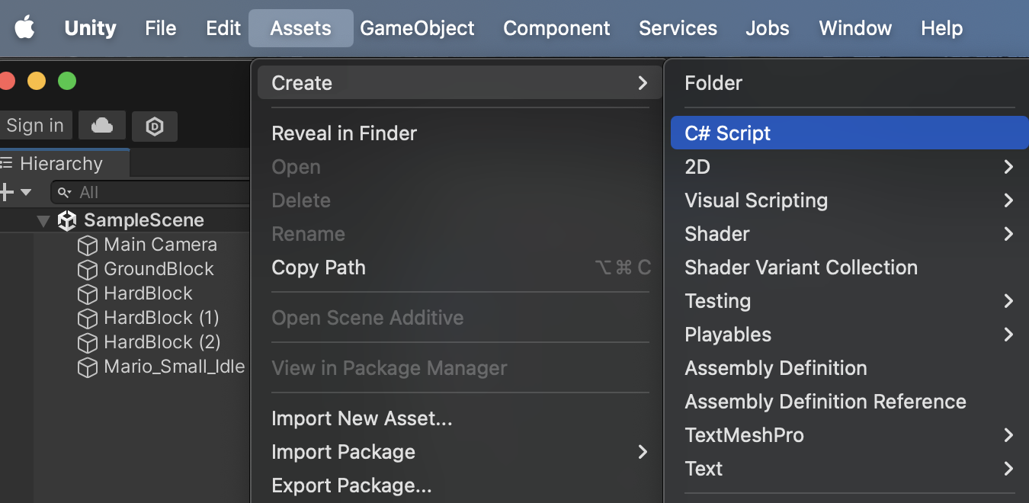
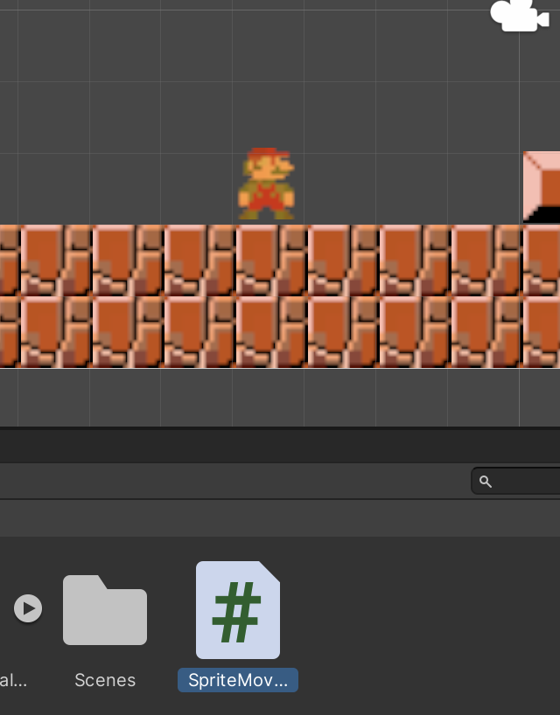
2. Mario Movement
Player

Slide 15
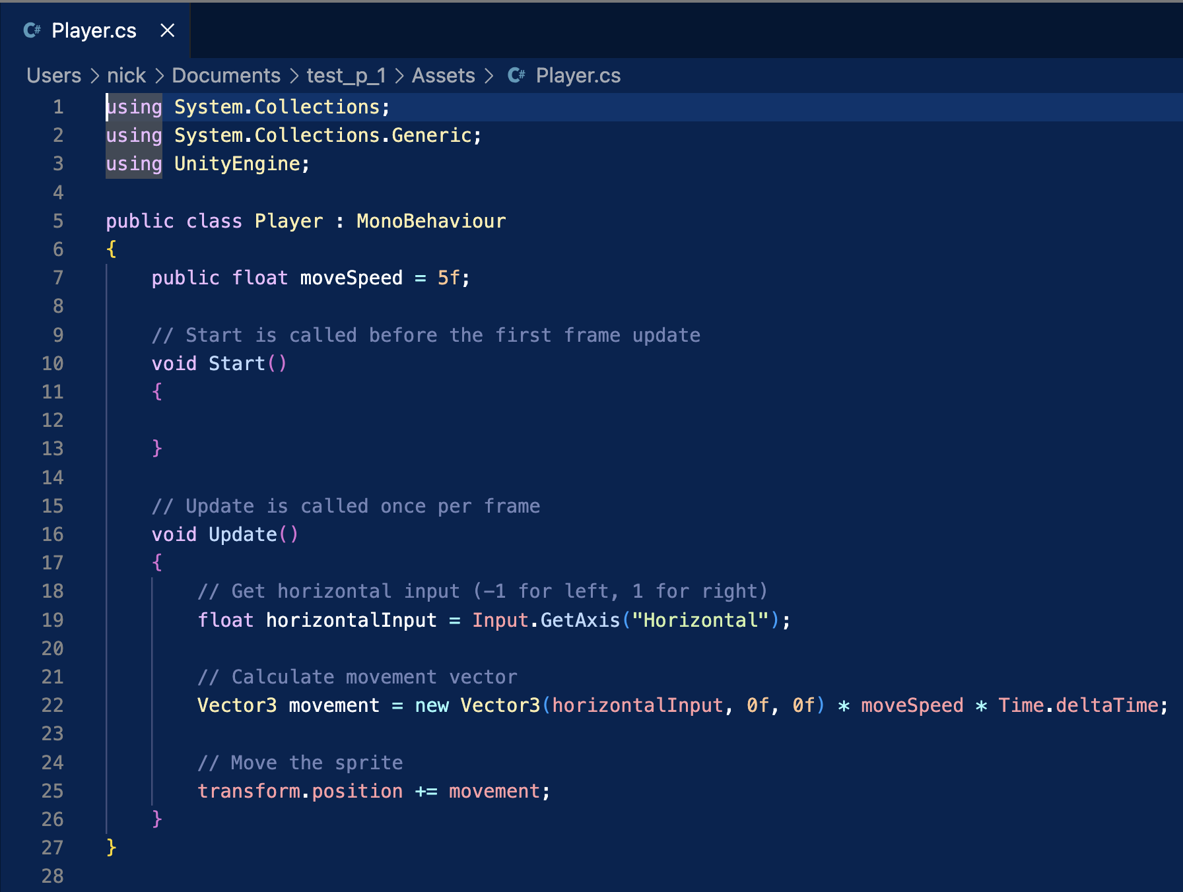
2. Mario Movement

Slide 16
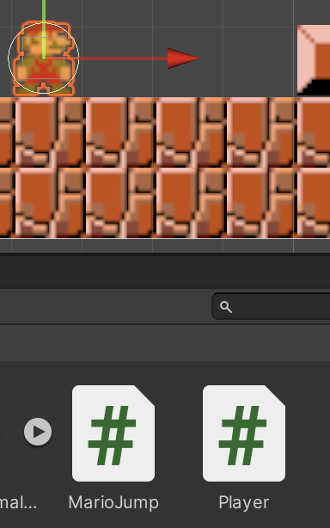
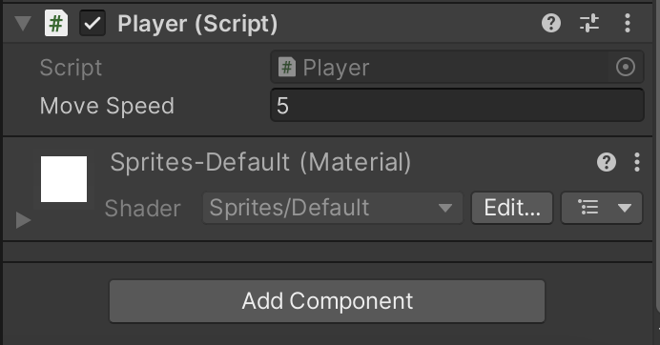
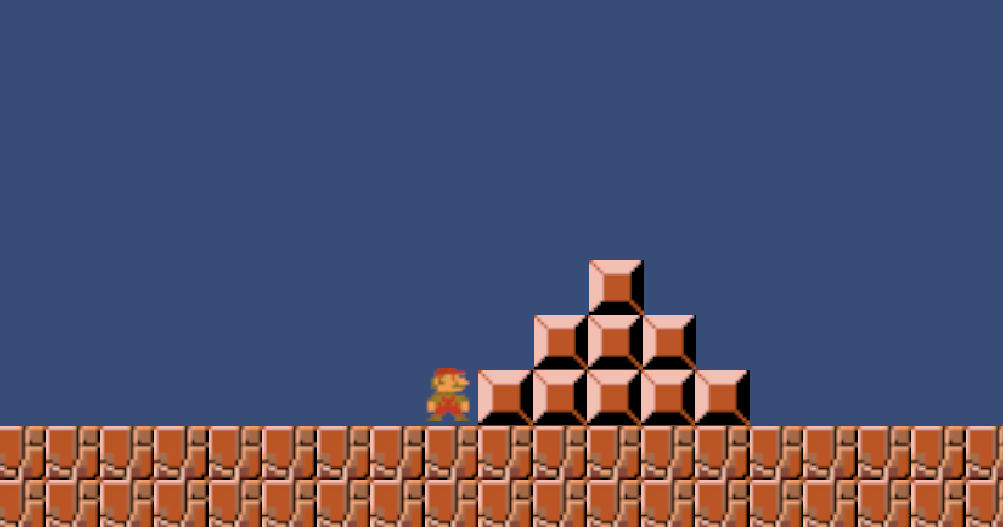
2. Mario Movement

Slide 17
Steps / Requirements
Level Design in Unity ✅
Mario Movement (left + right) ✅
Object detection / collision
Jumping over blocks / gravity
Enemies (Goombas) alternate directions
Jumping on Goombas – further collisions
Decoration – animation – walking
Camera to track Mario (once tile map created)

Slide 18
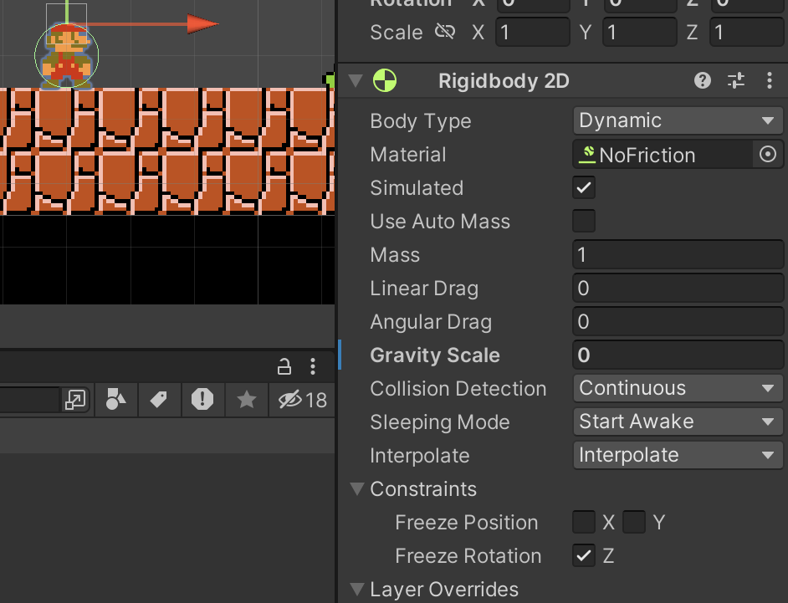
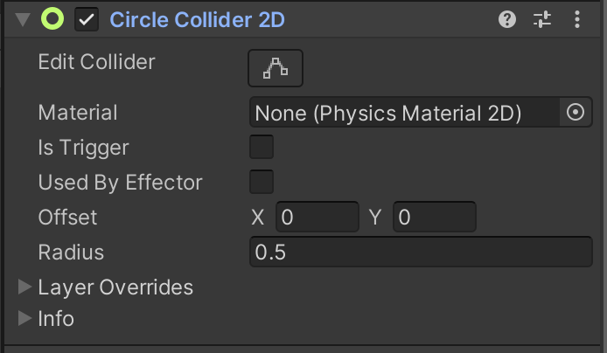
3. Object Detection – Colliders for Mario
Click on Mario – add new Component -> Physics -> Rigidbody 2D
Click on Mario – add new Component -> Physics -> Circle Collider 2D
Notes:
Click on Mario – add new Component -> Physics -> Circle Collider 2D

Slide 19
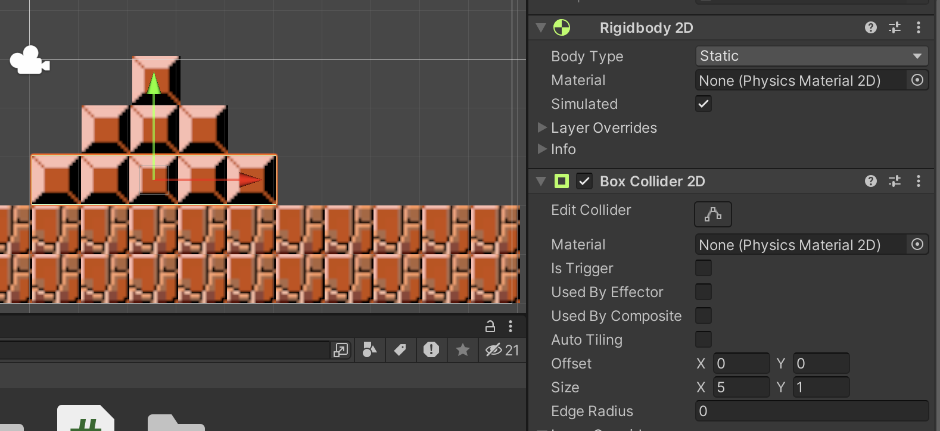
3. Object Detection – Colliders for Block
Click on Block – add new Component -> Physics -> Rigidbody 2D
Click on Block – add new Component -> Physics -> Box Collider 2D
Notes:
Click on Block – add new Component -> Physics -> Box Collider 2D

Slide 20
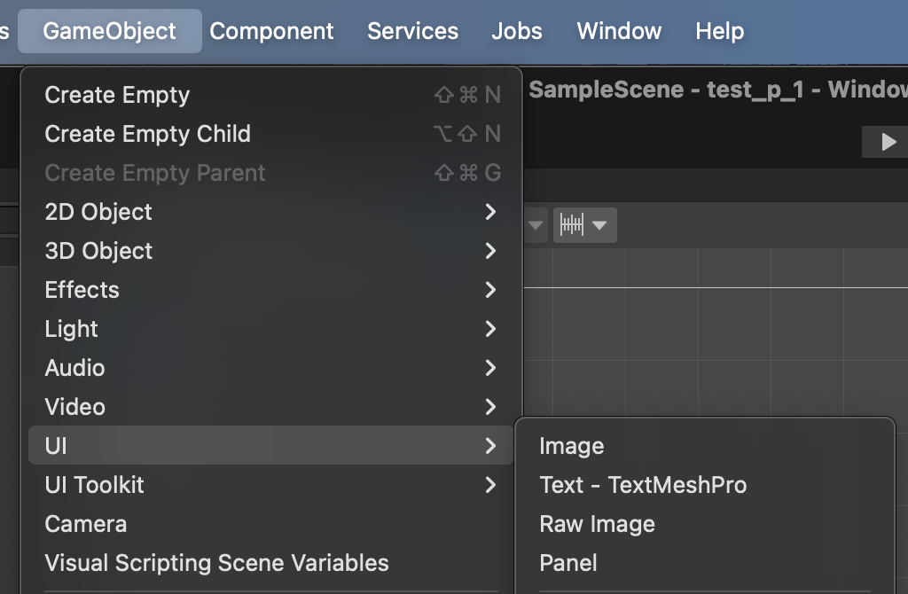
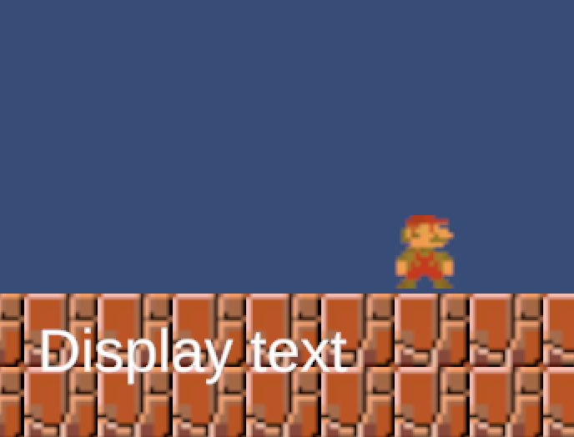
3. Collision text – for visual cues
GameObject -> UI -> Text - TextMeshPro

Slide 21
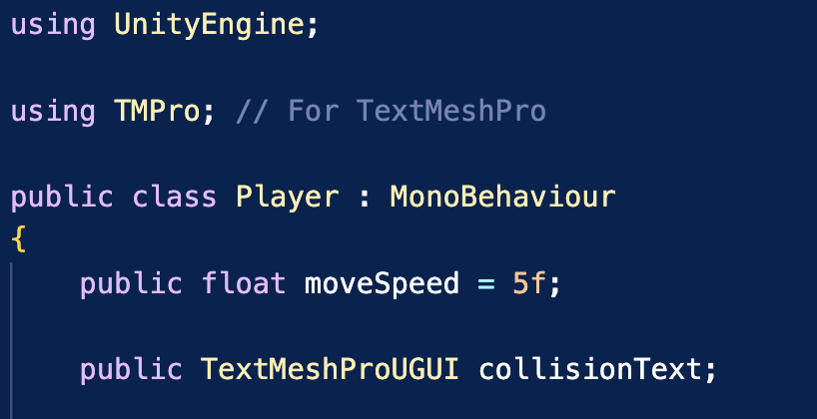
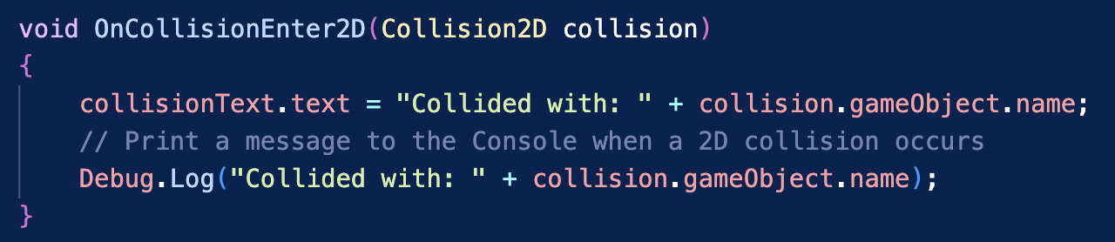
3. Collision code in our C# Script - for visual cues

Slide 22
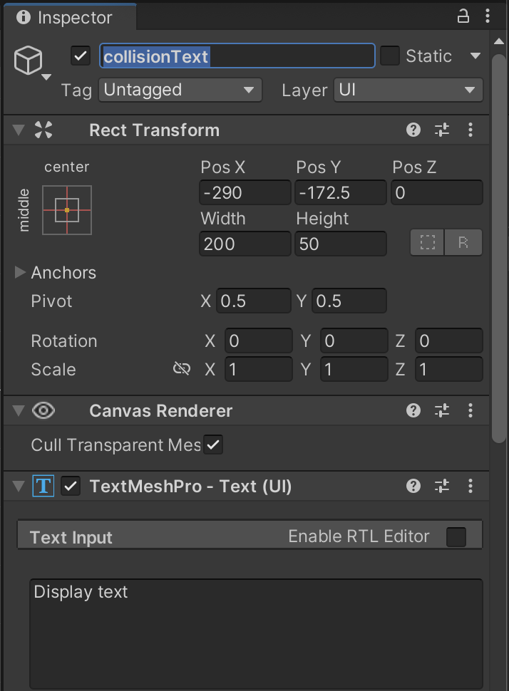
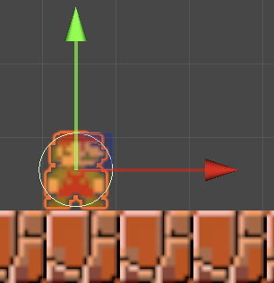
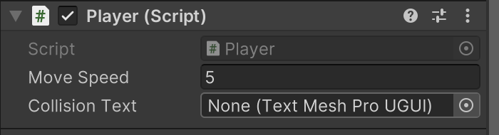
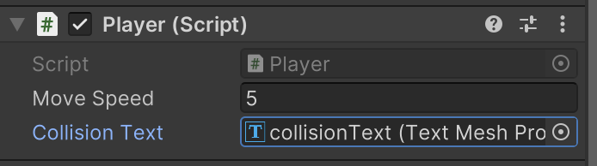
3. Update parameters in the Inspector

Slide 23
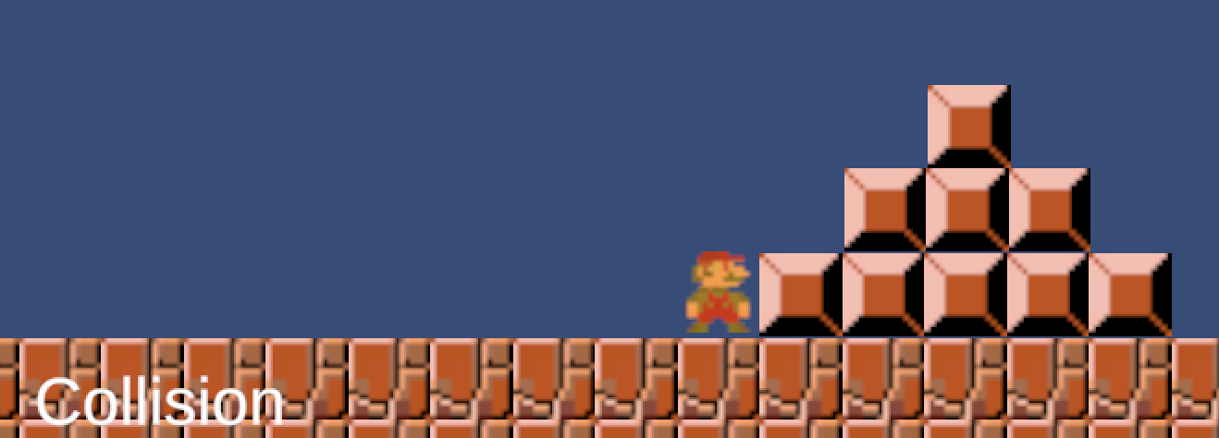
3. Change the TextMesh.text upon collision!
Notes:
Eventually helpful for drawing scores, times etc

Slide 24
Steps / Requirements
Level Design in Unity ✅
Mario Movement (left + right) ✅
Object detection / collision ✅
Jumping over blocks / gravity
Enemies (Goombas) alternate directions
Jumping on Goombas – further collisions
Decoration – animation – walking
Camera to track Mario (once tile map created)

Slide 25
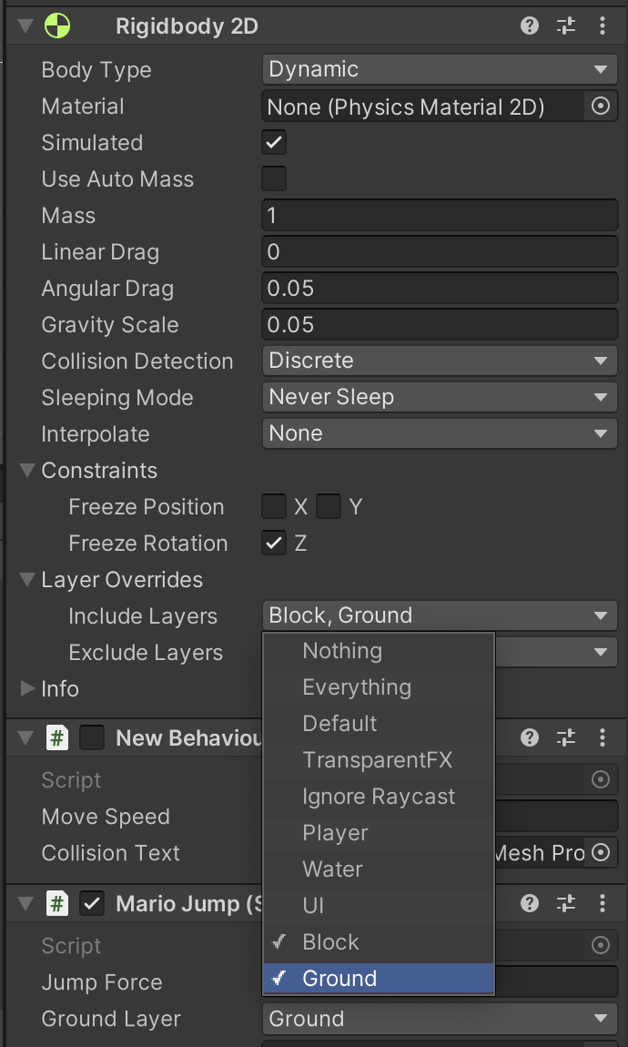
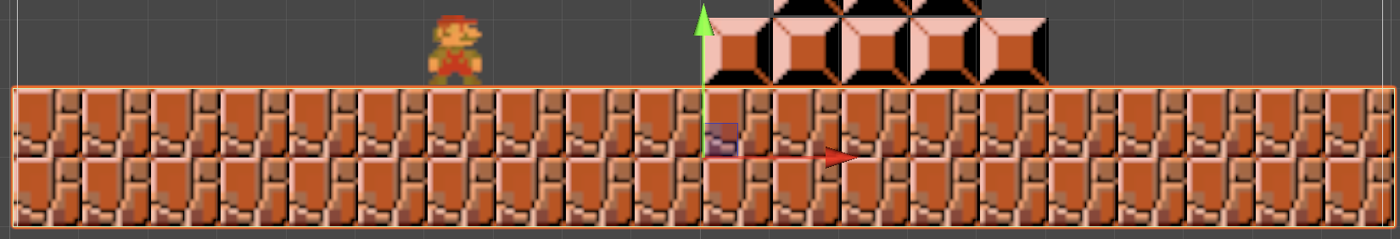
4. Gravity / Jump – Mario
Start by setting Mario’s RigidBody 2D Gravity to a low value > 0 but < 1 so you can check whether he falls through the floor or not…
Also make sure to ‘INCLUDE’ Ground tiles/layers you have

Slide 26
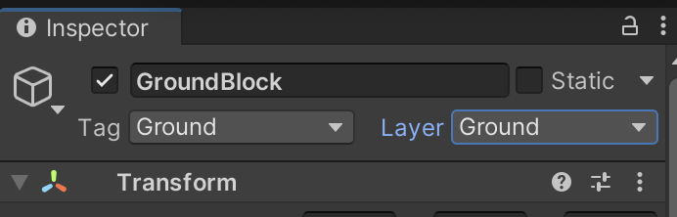
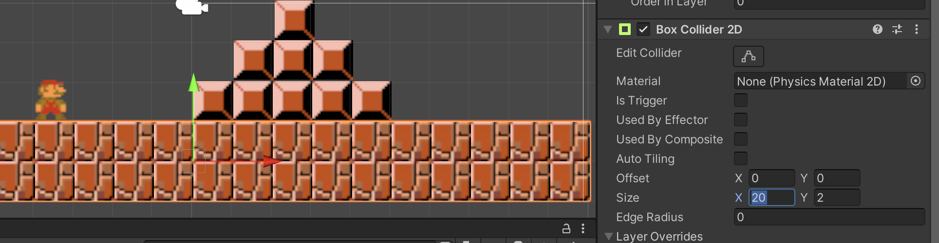
4. Gravity / Jump – Check Ground tiles
Ground tiles should only need a Box Collider 2D – I didn’t need to include a RigidBody 2D here

Slide 27
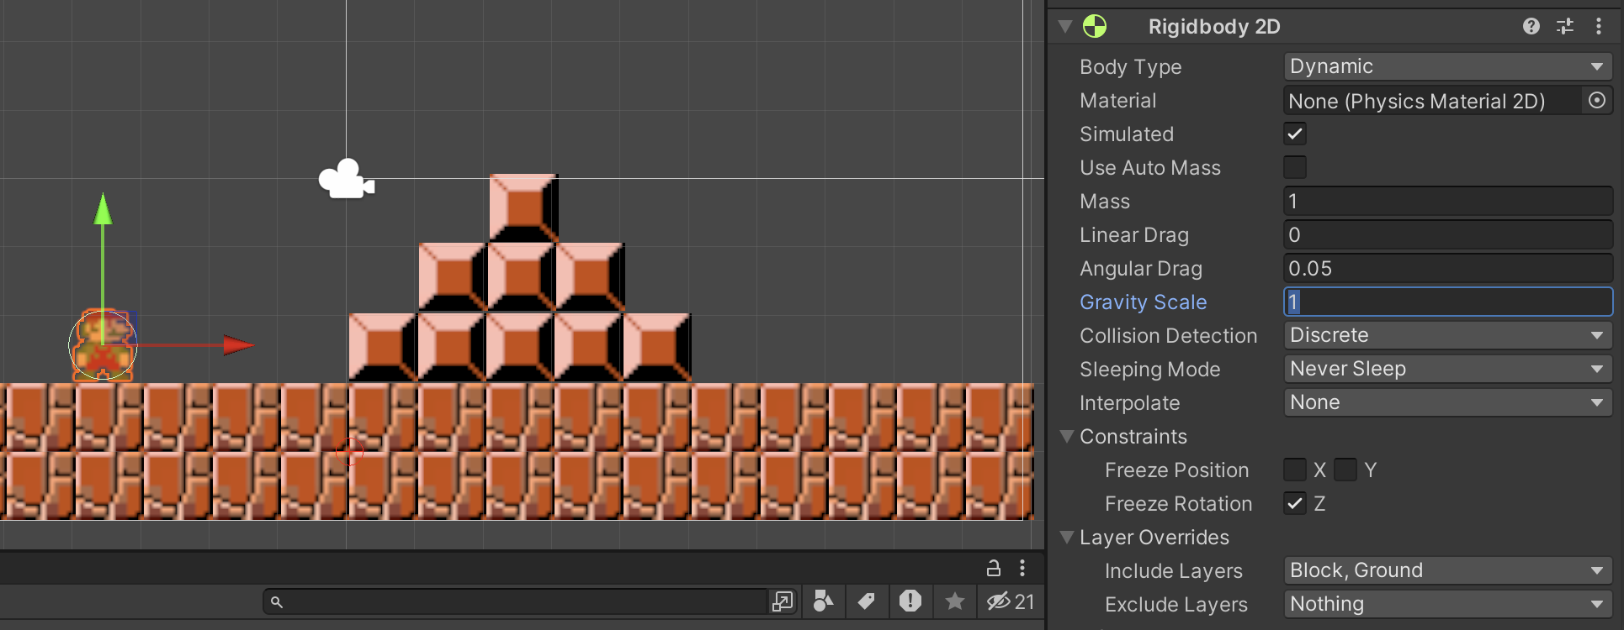
4. Gravity / Jump – Mario
If Mario doesn’t fall through the floor – then increase the Gravity Scale to 1 (or higher)

Slide 28
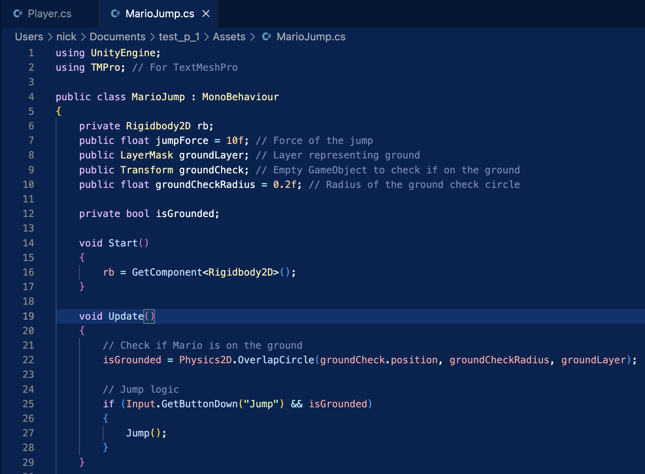
4. Gravity / Jump – C# Code

Slide 29
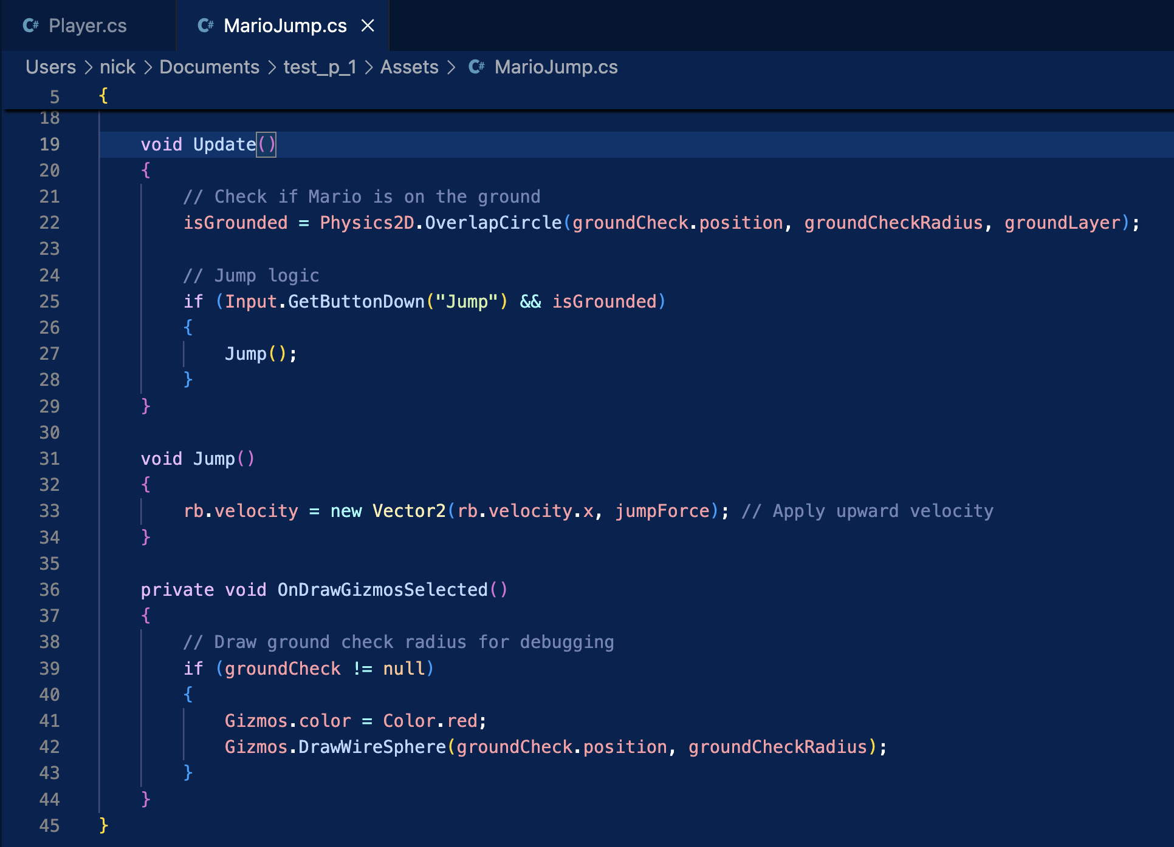
4. Gravity / Jump – C# Code

Slide 30
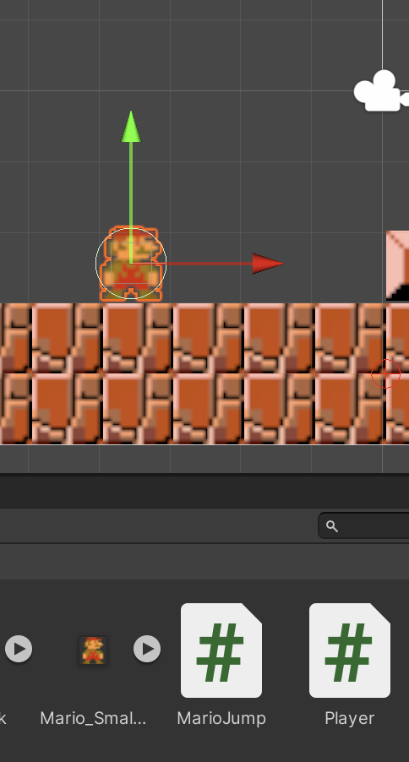
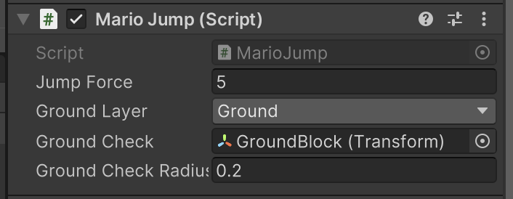
4. Gravity / Jump – Mario

Slide 31
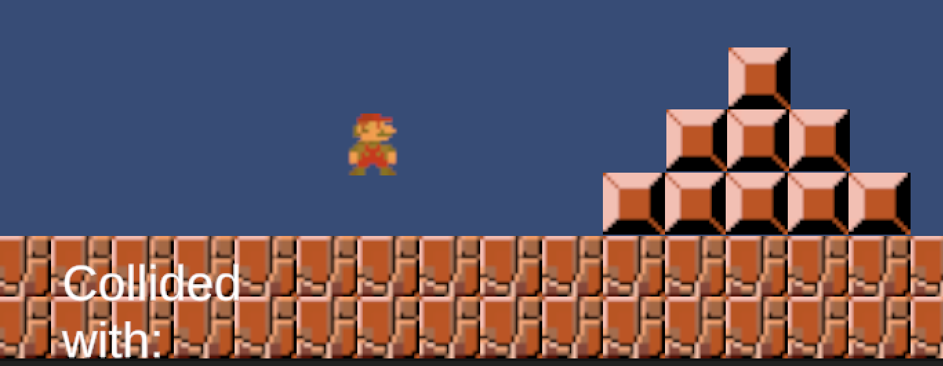
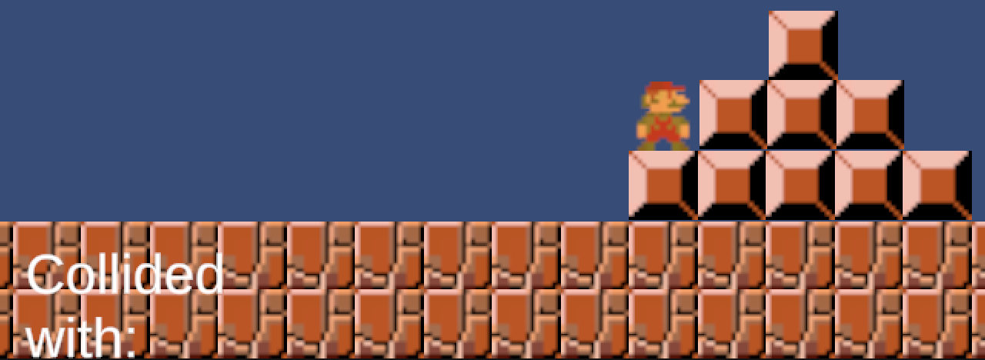
4. Gravity / Jump – Mario

Slide 32
Steps / Requirements
Level Design in Unity ✅
Mario Movement (left + right) ✅
Object detection / collision ✅
Jumping over blocks / gravity ✅
Enemies (Goombas) alternate directions
Jumping on Goombas – further collisions
Decoration – animation – walking
Camera to track Mario (once tile map created)

Slide 33
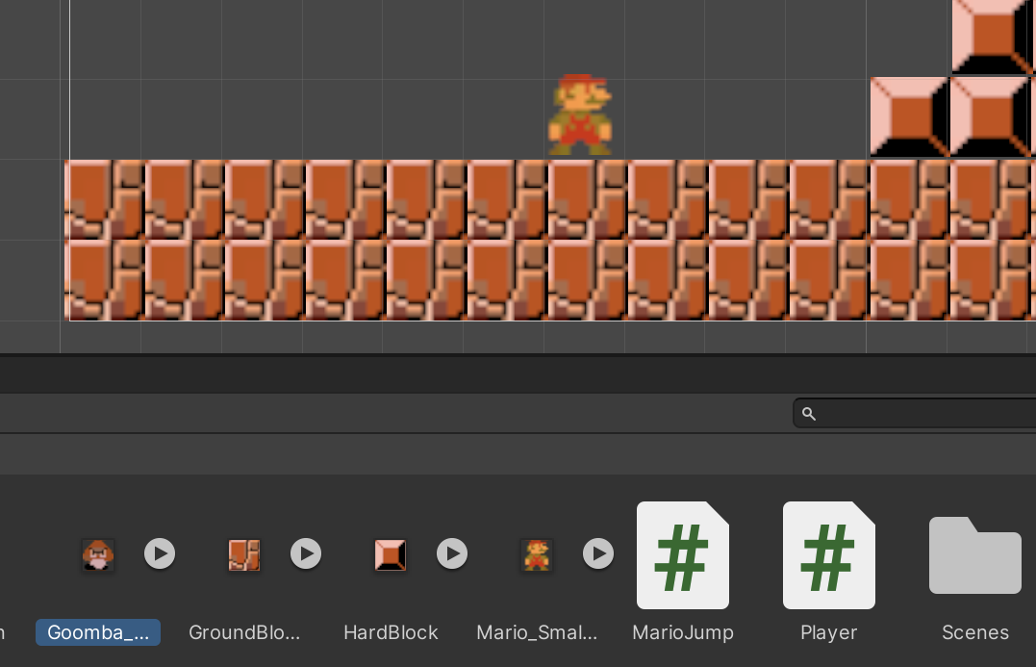
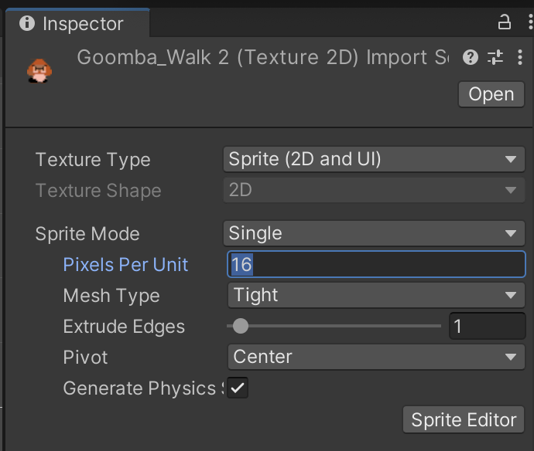
5. Goombas – set pixel per unit for asset

Slide 34
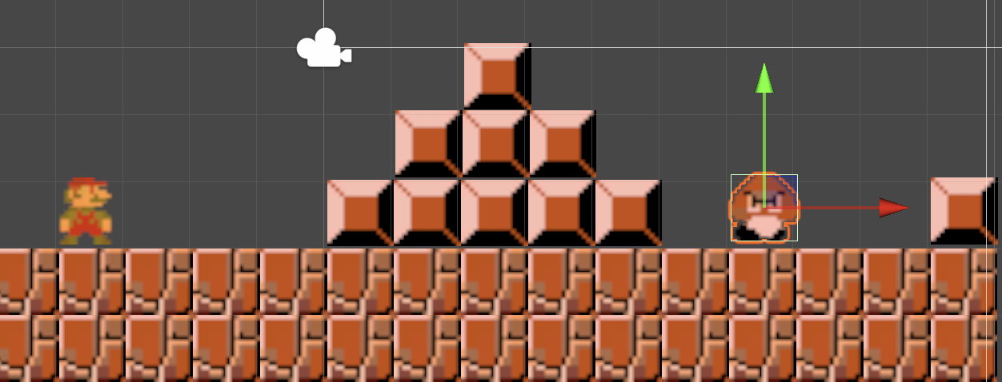
5. Goombas + Block

Slide 35
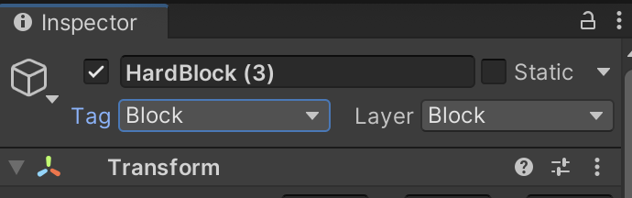
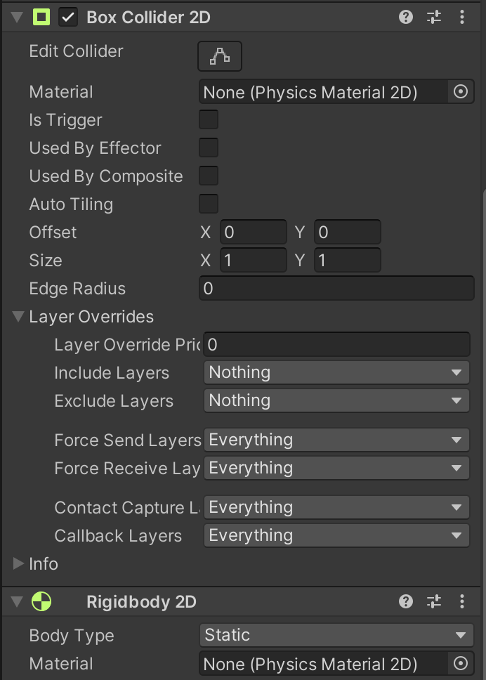
5. Goombas – add colliders

Slide 36
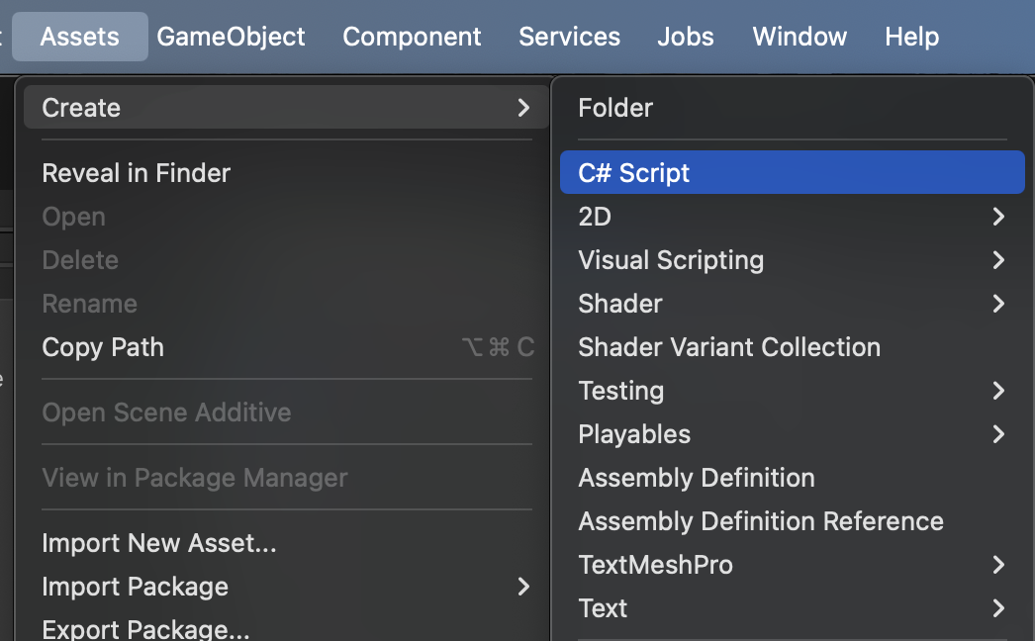
5. Goombas – add C# Script

Slide 37
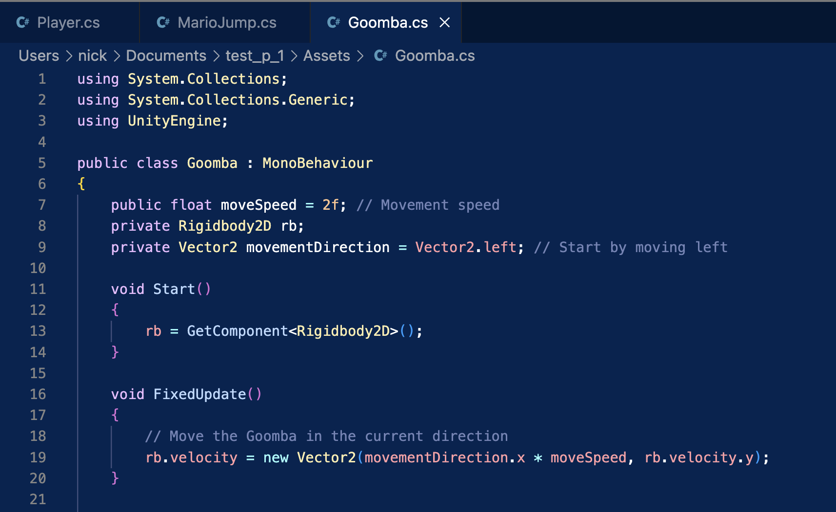
5. Goombas – C# Code

Slide 38
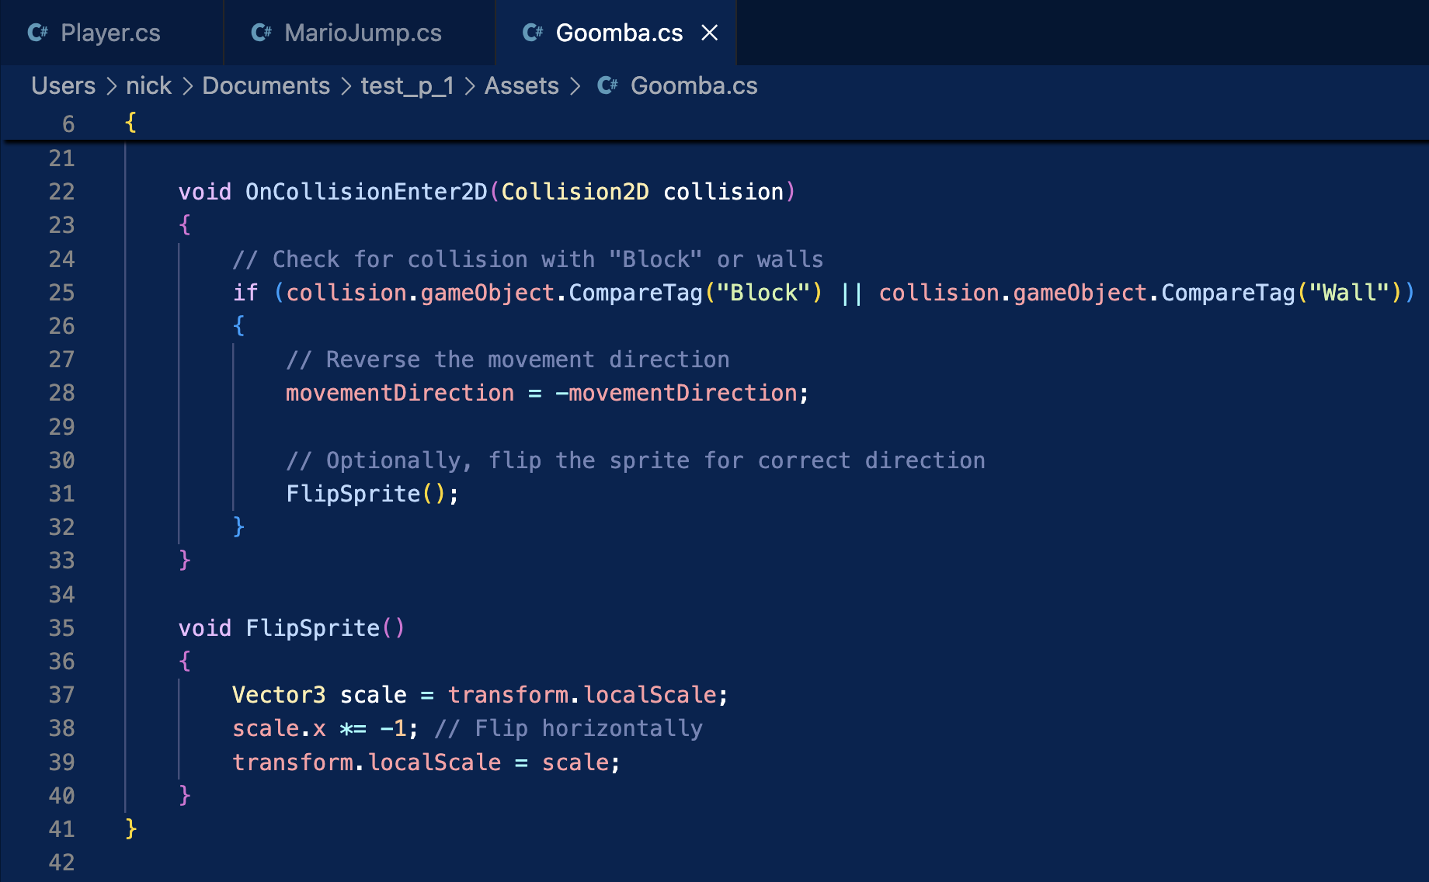
5. Goombas – C# Code

Slide 39


5. Goombas – add script

Slide 40


5. Goombas – alternate direction

Slide 41
Steps / Requirements
Level Design in Unity ✅
Mario Movement (left + right) ✅
Object detection / collision ✅
Jumping over blocks / gravity ✅
Enemies (Goombas) alternate directions ✅
Jumping on Goombas – further collisions
Decoration – animation – walking
Camera to track Mario (once tile map created)

Slide 42

6. Jumping on Goombas – set tags

Slide 43

6. Jumping on Goombas – modify the collision

Slide 44

6. Goombas – C# Code

Slide 45


6. Jumping on Goombas

Slide 46
Steps / Requirements
Level Design in Unity ✅
Mario Movement (left + right) ✅
Object detection / collision ✅
Jumping over blocks / gravity ✅
Enemies (Goombas) alternate directions ✅
Jumping on Goombas – further collisions ✅
Decoration – animation – walking
Camera to track Mario (once tile map created)

Slide 47


7. Animation

Slide 48


7. Animation

Slide 49


7. Animation
Make sure you have Mario selected as you open the ‘Animation’ tab

Slide 50

7. Animation

Slide 51

7. Animation
Sprite 1
Sprite 2
Sprite 1
I found I needed a ‘copy’ of the first sprite at the end for a ‘smoother’ animation
This is so Sprite 1 and Sprite 2 had roughly the same time in the loop.

Slide 52

7. Animation
Sprite 1
Sprite 2
Sprite 1

Slide 53

7. Animation
Sprite 1
Sprite 2

Slide 54


7. Animation
Sprite 1
Sprite 2
Sprite 1

Slide 55
Steps / Requirements
Level Design in Unity ✅
Mario Movement (left + right) ✅
Object detection / collision ✅
Jumping over blocks / gravity ✅
Enemies (Goombas) alternate directions ✅
Jumping on Goombas – further collisions ✅
Decoration – animation – walking ✅
Camera to track Mario (once tile map created)

Slide 56


8. Camera – first extend the floor

Slide 57


8. Camera – update your box collider!

Slide 58

8. Camera – locate the ‘Main Camera’ object

Slide 59


8. Camera – Drag the Main Camera onto Mario
Then the camera should then move with Mario as he moves right

Slide 60
Steps / Requirements
Level Design in Unity ✅
Mario Movement (left + right) ✅
Object detection / collision ✅
Jumping over blocks / gravity ✅
Enemies (Goombas) alternate directions ✅
Jumping on Goombas – further collisions ✅
Decoration – animation – walking ✅
Camera to track Mario (once tile map created) ✅

